Slide 1





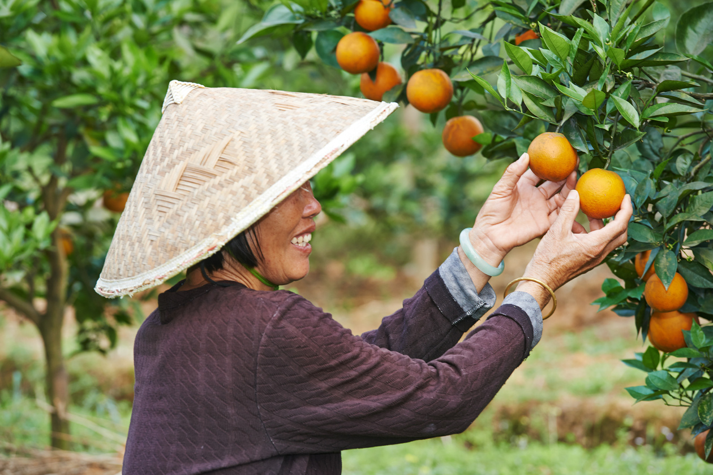

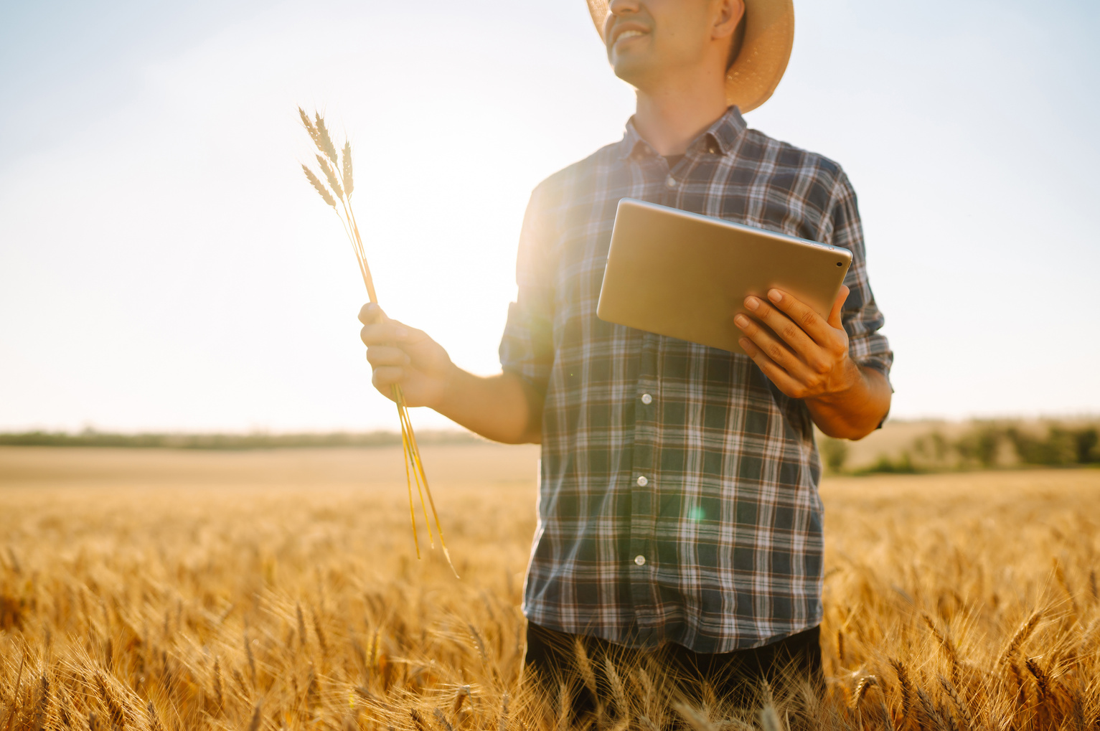



Project No. 024-1-IE01-KA220-VET-000254134
Adapting agri-recreation activities
Creating accessible and engaging agritainment experiences for everyone
The European Commission's support for the production of this publication does not constitute an endorsement of the contents, which reflect the views only of the authors, and the Commission cannot be held responsible for any use which may be made of the information contained therein.

Slide 2


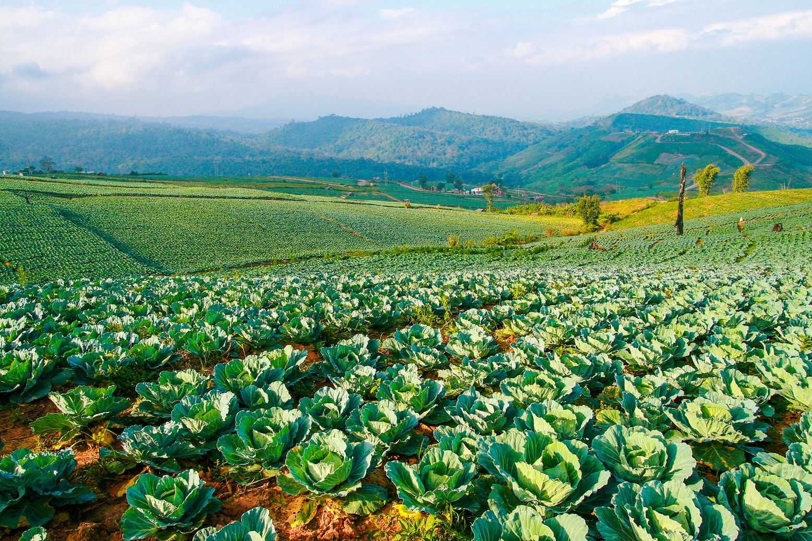


Introduction
Adapting agritourism activities to be inclusive
Focus on physical, sensory, cognitive & developmental disabilities
Removing barriers and enhancing participation
Using creativity and Universal Design principles

Slide 3



Why Adapt Agritainment?
01
Everyone deserves equal access to experiences
02
Inclusive activities improve engagement
03
Benefits visitors, families, and communities
04
Strengthens social inclusion

Slide 4


Accommodations for Physical Disabilities
01
Wide, firm, level accessible paths
02
Adapted tools
Wide, firm and level pathways allow safe and easy movement between farm areas and crops.
Extended-handle and easy-grip tools help visitors participate comfortably in harvesting and activities.
03
Stools or benches for resting
04
Pre-picked produce options
Stools and small benches provide regular breaks and reduce physical fatigue.
Ready-to-collect products ensure participation for visitors with limited mobility.

Slide 5



01
Accessible viewing & petting areas
Farms, Zoos & Stables
02
Calm and friendly animals
03
Seated interaction spaces
04
Staff assistance available

Slide 6


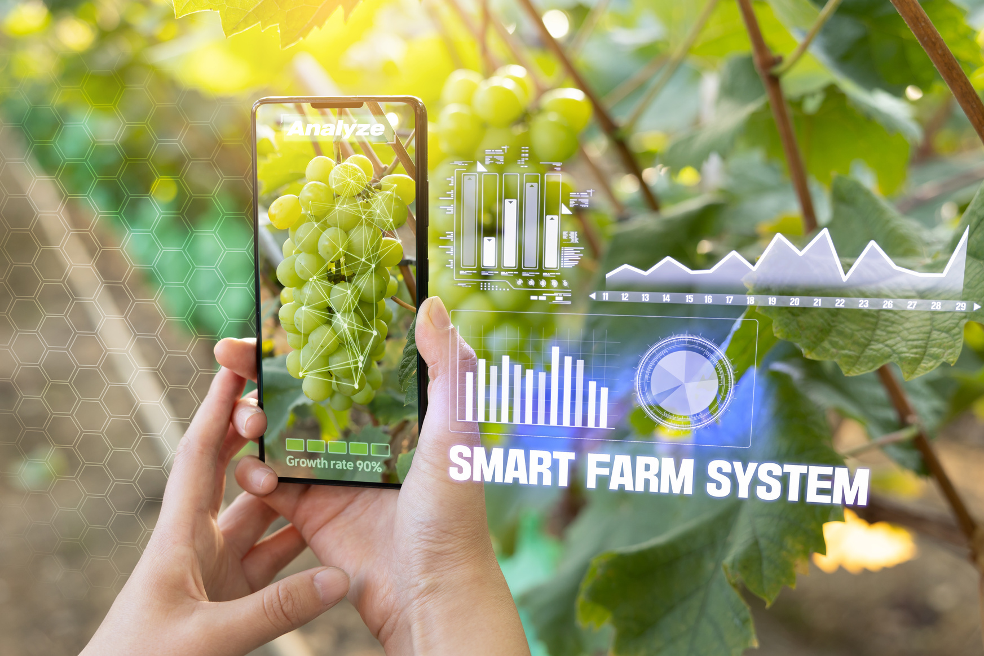
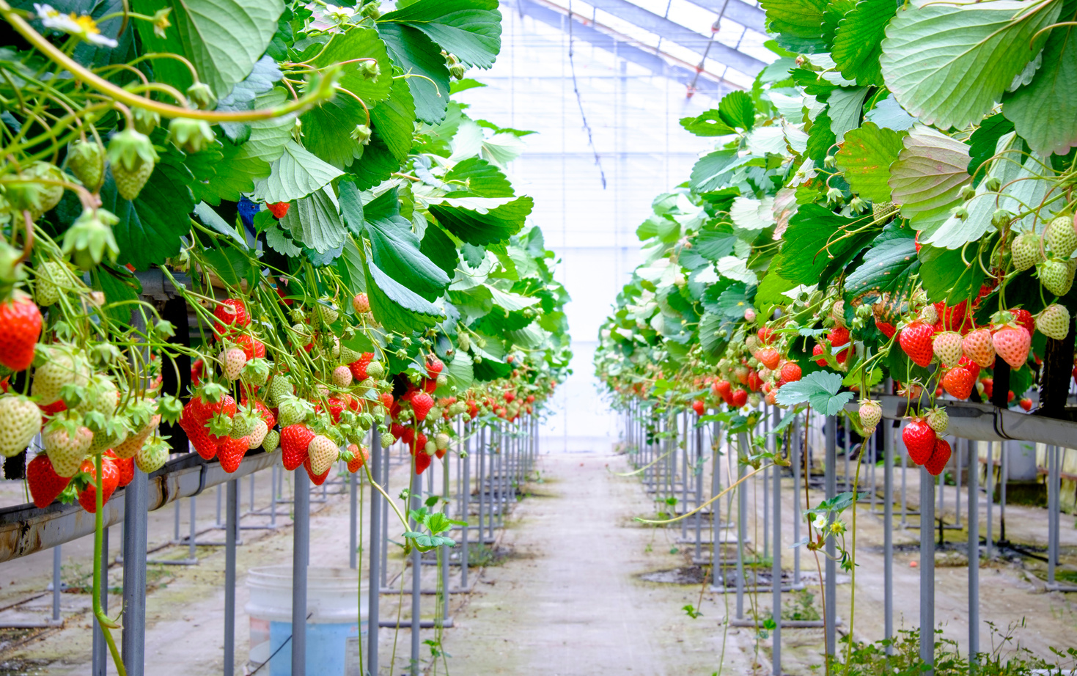
01
Accessible vehicles with ramps or lifts
02
Alternative accessible routes or virtual tours
Farm Tours & Play Areas
03
Large clear visual aids
04
Inclusive playground equipment
05
Trained staff available to support boarding and movement
06
Clearly marked accessible areas and routes

Slide 7


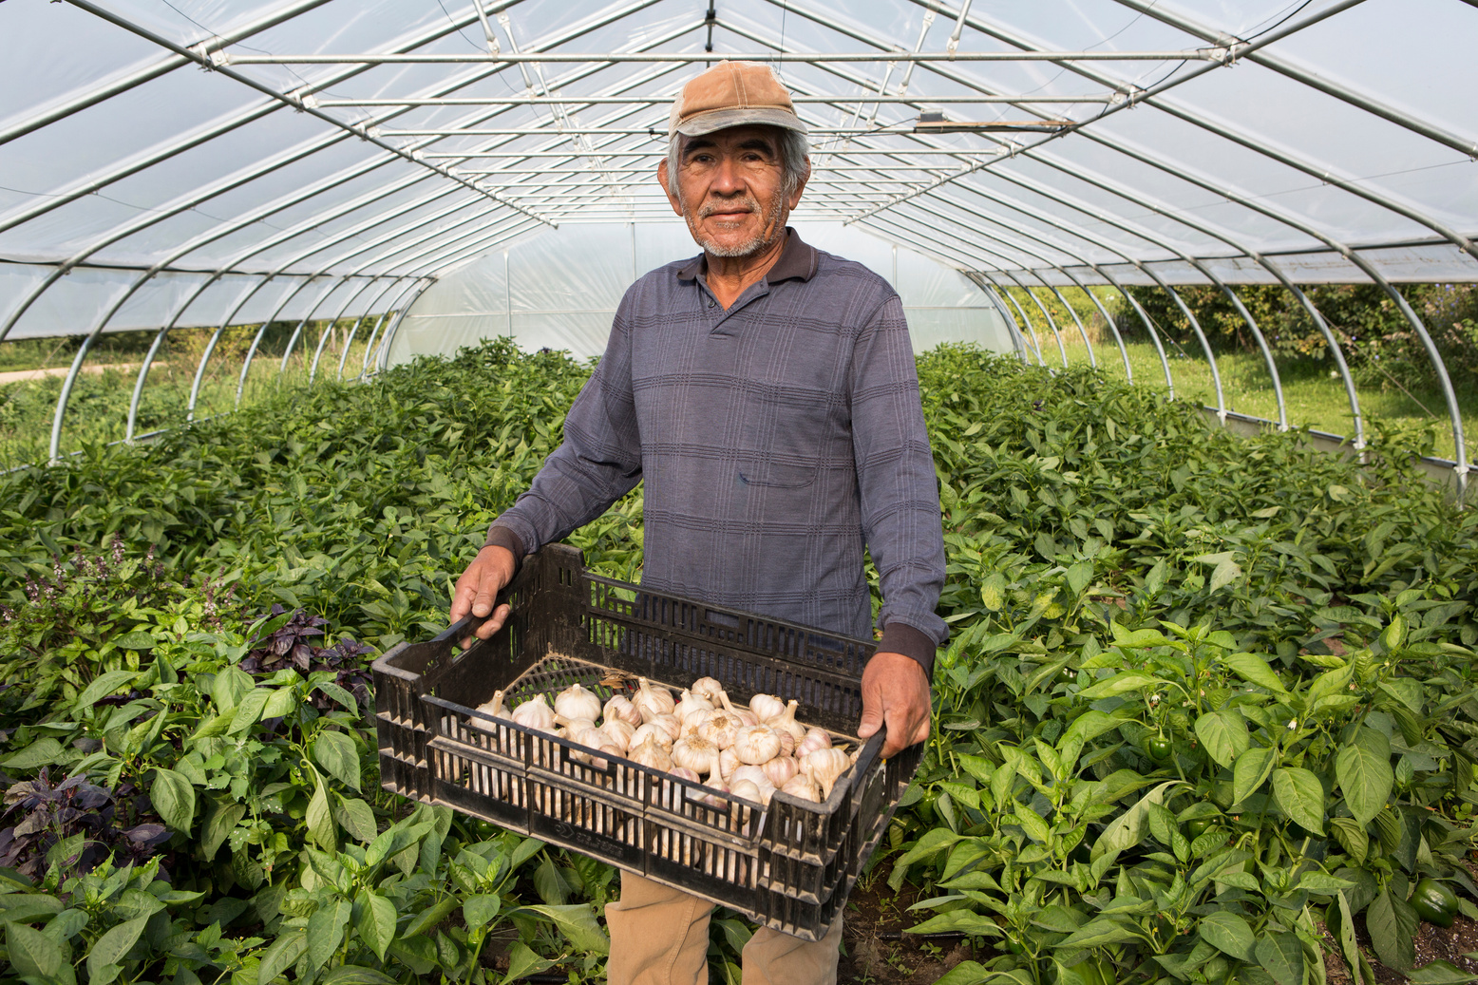



Sensory Disabilities
Clear Navigation
Tactile Support
Audio & Visual Access
Wide, obstacle-free paths help visitors move safely and independently.
Maps and small models allow users to explore farm layouts by touch.
Audio guides, high contrast signs and good lighting improve understanding.

Slide 8


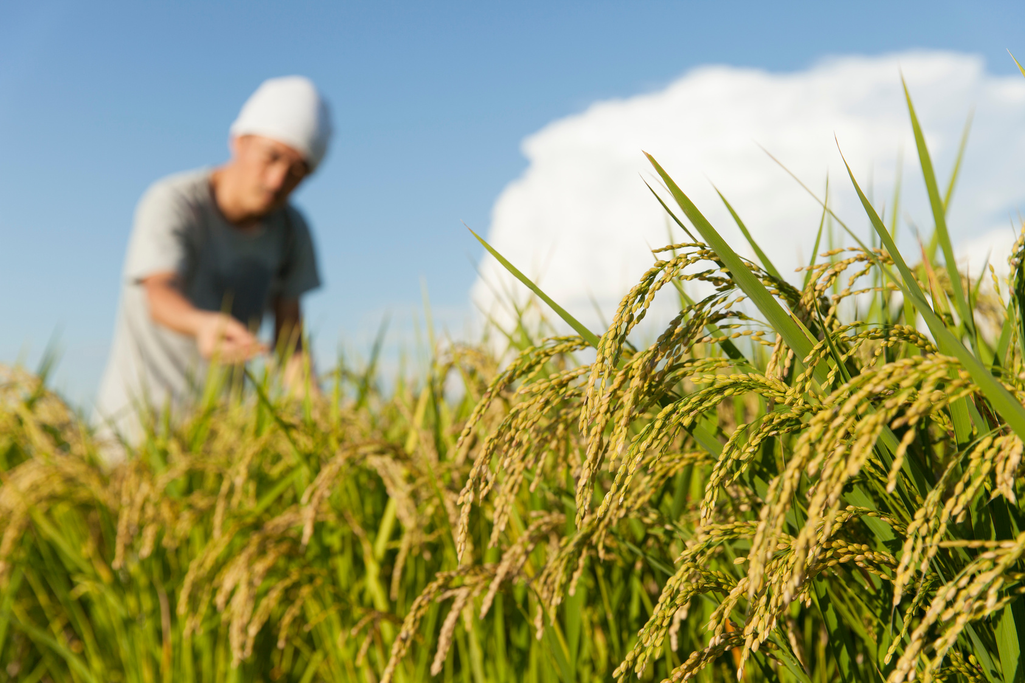

Sensory Disabilities
Visual Learning
Pictures, demonstrations and videos support understanding.
Written Information
Instructions and transcripts replace spoken explanations.
Communication Support
Sign language interpreters and hearing loop systems improve access.

Slide 9
Cognitive & Developmental Disabilities
Simple Communication
Short and clear instructions reduce confusion.
Structured Activities
Predictable routines and step-by-step tasks support participation.
Sensory Comfort
Quiet spaces and sensory-friendly areas reduce stress.

Slide 10


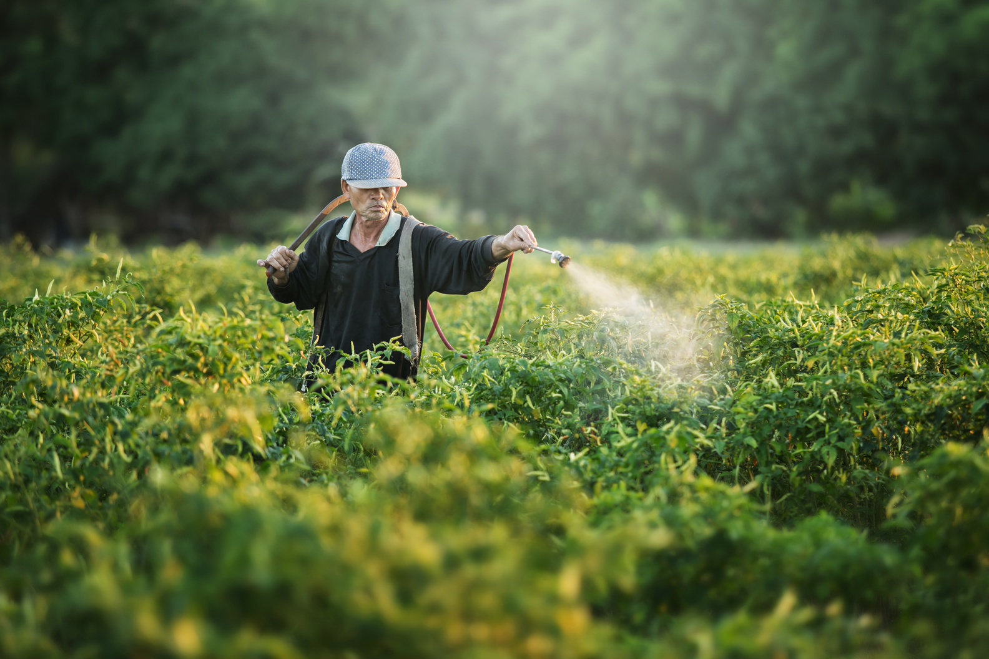

Animal Interactions
Guided Contact
Staff lead safe and calm animal interactions.
Clear Boundaries
Visual cues show where visitors should stand.
Step-by-Step Support
Simple visual guides explain how to interact with animals.

Slide 11
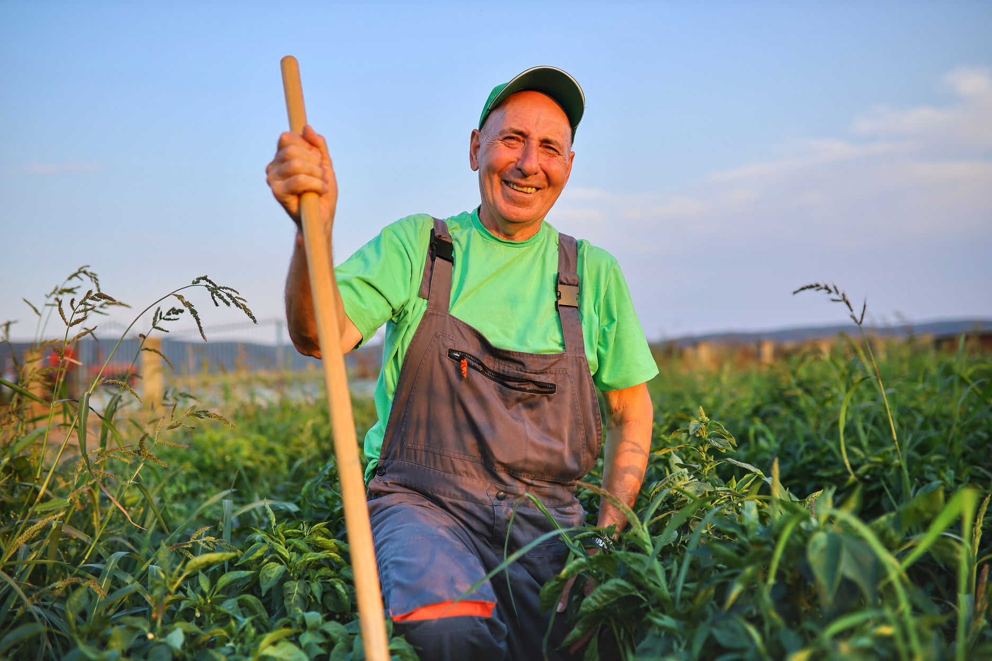
Farm Visit Adaptations
Easy Participation
Pre-packed produce allows everyone to join harvesting activities.
Visual Guidance
Images show ripe fruits and vegetables clearly.
Personal Assistance
Staff provide individual help when needed.
https://greenagritainment.com/

